Slide 1
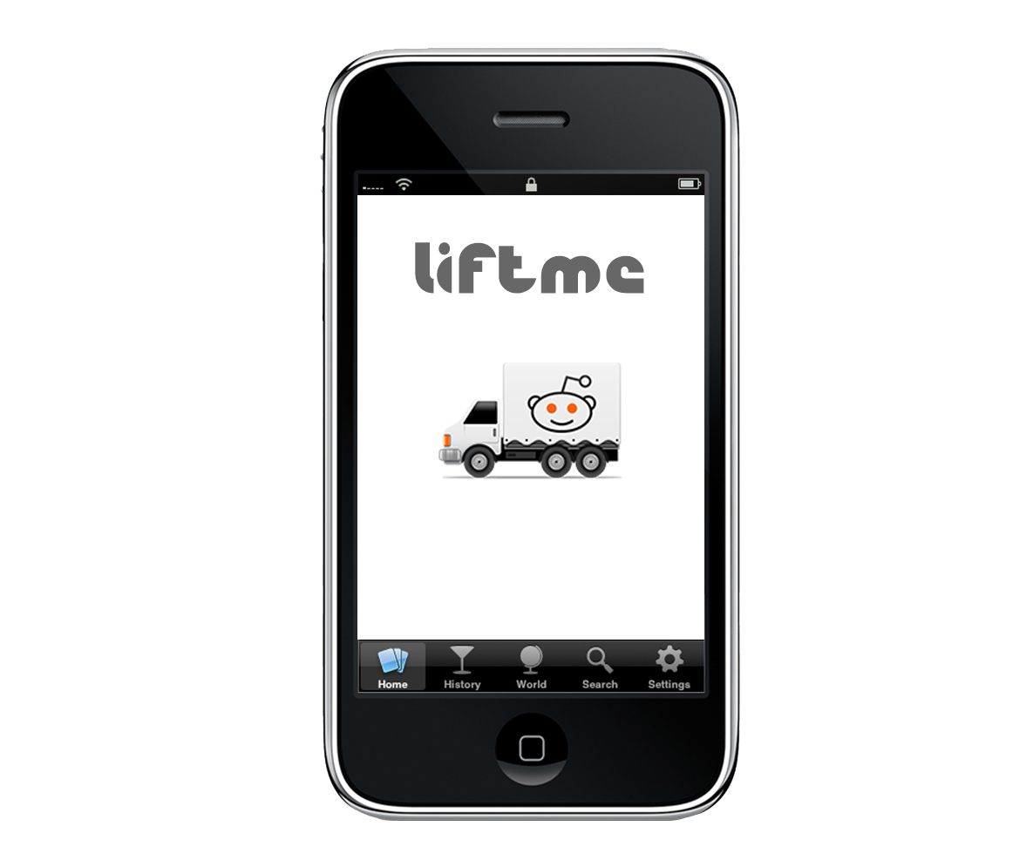

Slide 2
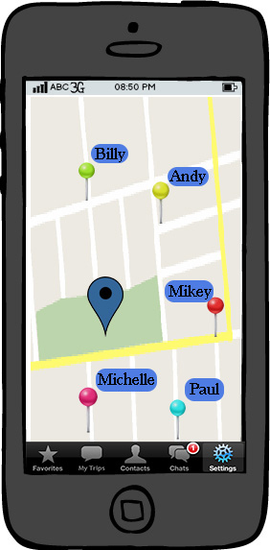
The Main Screen
This is the main screen of the app
It shows the current location of the user and other ping users around the user, with their usernames.
The user can touch the other users to send a message or he can zoom in or out.
He can pulls the search tab from the top of the screen.
At the bottom there is the options tab where the user can look at his favorite users, previous trips, contacts, chats and settings

Slide 3
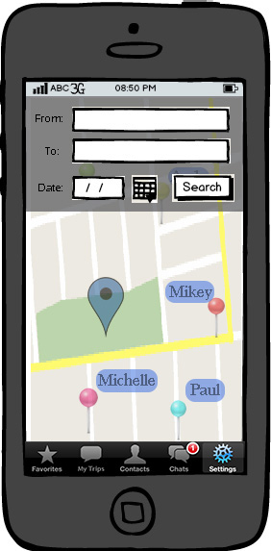
The Search Tab
Here is the search tab of the app.
The user enters the location and the destination with the date and time and searches that who is going or passing from that route.
The map is active at the backround, the opticality is a bit low.

Slide 4
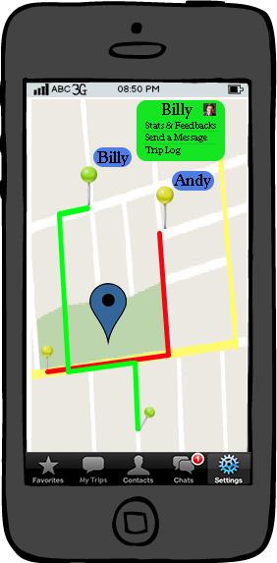
Interacting with Other Users
After the user enters the route, the app shows other users passing or going to the same direction.
The user can tap on the user to send a message, see the feedbacks about him and to look at the trip log.

Slide 5
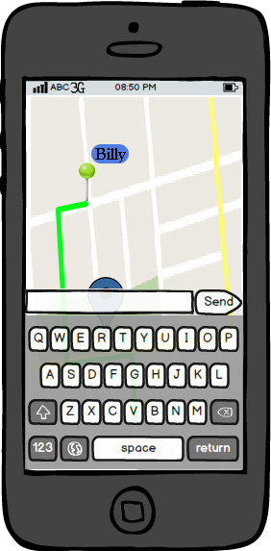
Interacting with Other Users
When he taps on a user to send a message, the other options dissapear.
The map is active in the background and the keyboard appears on the screen.

Slide 6
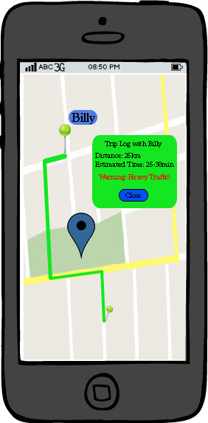
Interacting with Other Users
Here is the trip log interface of the app.
It shows the distance and estimated travel time to the user.
The app looks at the traffic and than calculates the estimated time. If there is heavy traffic, than it warns the user.

Slide 7
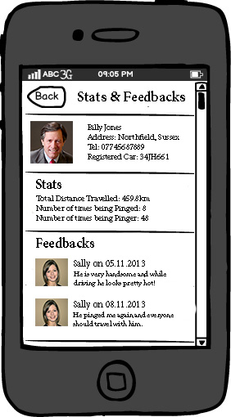
Interacting with Other Users
Here is the stats & feedbacks page of the app where the user can see detailed information about a specific user.
The address, Tel No, and the registered car info are appeared on the screen together with stats of previous trips and feedbacks from other users.

Slide 8
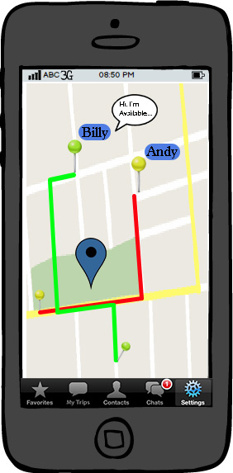
Interacting with Other Users
If a message comes from the other users, a baloon appears on the icon.
The user can tap on the baloon to see the message

Slide 9
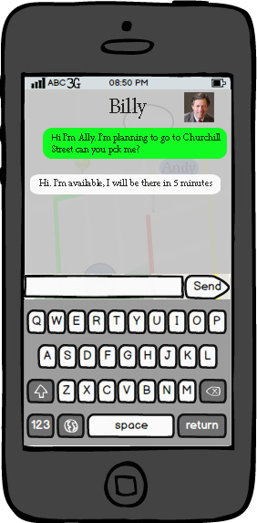
Interacting with Other Users
Here is the chat screen between the user
It is a bit transparent and the map is still active on the background.
There is also a profile picture of the other user.

Slide 10
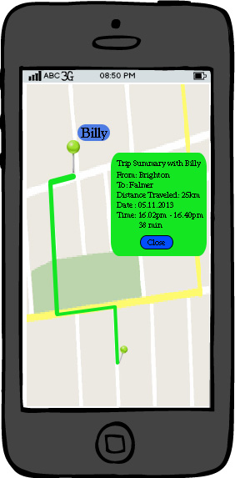
Trip Summary
After having the trip, the summary page appears on the screen.
The user can also see this trip summary and the other trip summaries from my trips at the option bar at the bottom.

Slide 11
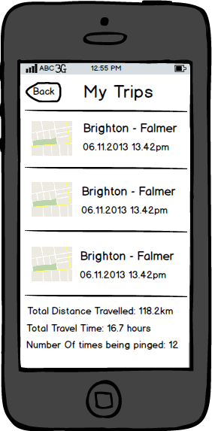
My Trips
Here is the my trips page where the user can see his previous trips and total stats at the bottom of the page.
User can tap on the trip to see the trip on the map with detailed information.

